Slide 1
JS for Beginners
Class - 4

Slide 2
Last chapter Review…
Generate the express framework using express-generator
Add configuration specific to the project (config folder aka env files)
Add your necessary dependencies (package.json)
Connect database to the project(app.json)
Rearrange the file structure(routes …)
Add Modules(based on your application)

Slide 3
Class Objective
Designing Database (schema)
Creating Logic Controllers for CRUD
API’s to connect Controller
Testing the API with POSTMAN
Setting up VIEW Designs

Slide 4
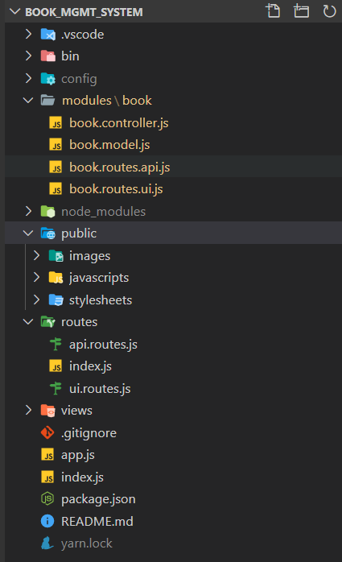
Last Class

Slide 5
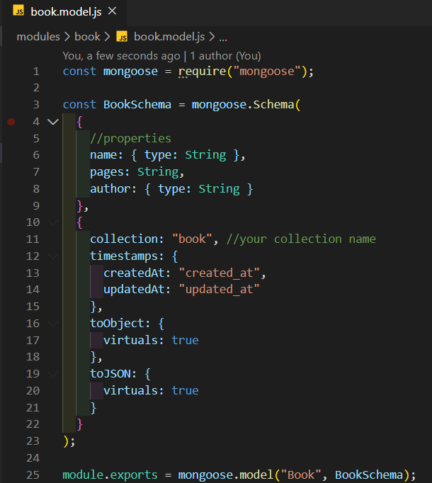
Designing Schema
Goto Modules/book/book.model.js
Add the object property that defines the database model
Rename your collection as your need

Slide 6
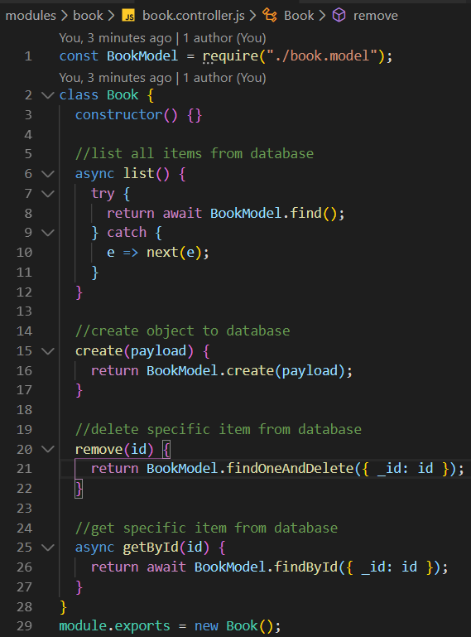
Defining Controllers
Include the model in controller
Initialize the class with module name
Create the empty functions for CRUD Operations
Write code to interact with database in each function

Slide 7
Basic Routing [API Methods]
Methods
GET
List/get individual details
POST
Add new data
PUT/PATCH
update the existing data
DELETE
deleting the existing data

Slide 8
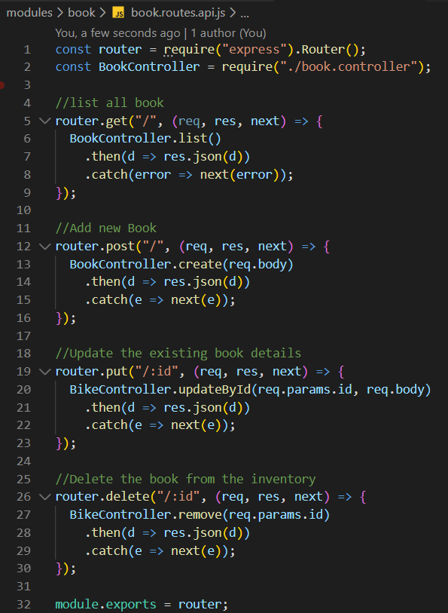
Writing APIs
Include the router in this page
Include the controller which needs to be called by router
Mention the Methods by which router will be invoked
Call the specific controller regarding that api routes
Return the data in JSON format

Slide 9
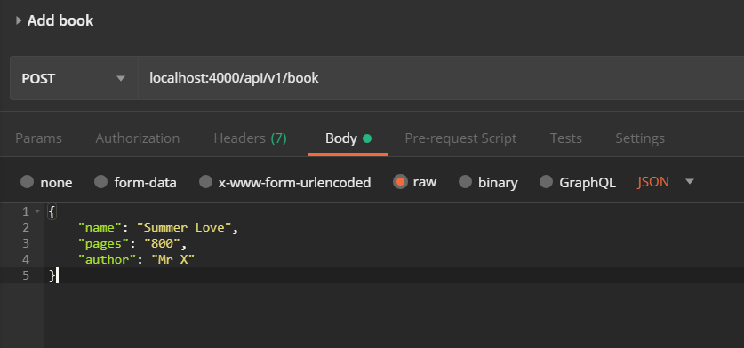
Test the API in POSTMAN
Choose method from dropdown
Write the api url
Select the BODY option
Select raw format and JSON in dropdown
Give the Object in the input text area
Note
Object should be exact as our model is designed

Slide 10
Picking View Designs for our App
Google search for free HTML5 Templates
Example: https://themehunt.com/item/1527507-boighor-free-books-library-ecommerce-store
Remove unnecessary component from the theme (Cleaning)
Add the theme in the view (index, list and create page)
Add theme assets to public folder

Slide 11
BUILDING CRUD APPLICATION PART 2
Github Link: https://github.com/rakimsth/book_mgmt_system

Slide 12
Q & A

Slide 13
Assignments
CREATE YOUR OWN ANY KIND OF
CRUD APPLICATION

